Slide 1
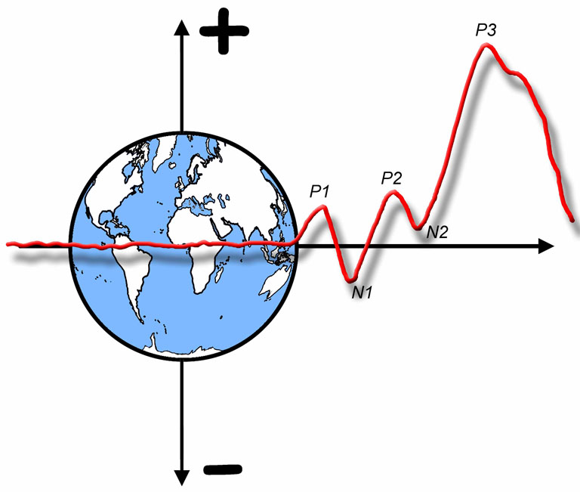

The ERP Boot Camp
Design and Interpretation of ERP Experiments

Slide 2
What is an ERP component?
Early definition: Combination of polarity, latency, and scalp distribution
C1: Polarity varies with upper/lower position
P3: Latency varies with stimulus evaluation time
Auditory N1: Distribution varies with pitch
Circular definition: The effect produced by a given experimental manipulation
“N400 is the difference produced by a semantic mismatch”
Conceptual definition: Scalp-recorded neural activity that is generated in a given neuroanatomical module when a specific computational operation is performed
Operational definition: A set of voltage changes that are consistent with a single neural generator site and that systematically vary in amplitude across conditions, time, individuals, etc. That is, an ERP component is a source of systematic and reliable variability in an ERP data set. (Adapted from Donchin et al., 1978)
Notes:
© S. J. Luck. All Rights Reserved. May be used for nonprofit educational purposes if this copyright notice is included. Permission must be obtained from the copyright holder(s) for any other use.

Slide 3
Peaks and Components
An ERP waveform contains several peaks
People typically assume that each peak corresponds to a single underlying “latent” component
Notes:
© S. J. Luck. All Rights Reserved. May be used for nonprofit educational purposes if this copyright notice is included. Permission must be obtained from the copyright holder(s) for any other use.

Slide 4


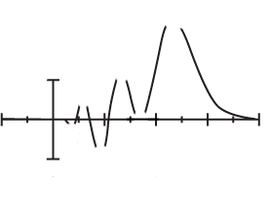
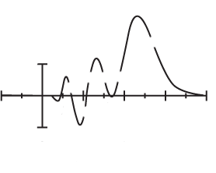
Perceptual Importance of Vertices
Notes:
© S. J. Luck. All Rights Reserved. May be used for nonprofit educational purposes if this copyright notice is included. Permission must be obtained from the copyright holder(s) for any other use.

Slide 5

The Superposition Problem
C1
C2
C3
w_{1,1}
E1
w_{2,1}
w_{3,1}
w_{1,2}
w_{2,2}
E2
w_{3,2}
w_{1,3}
w_{2,3}
E3
w_{3,3}
E1
E2
Voltage at an electrode at time t is a weighted sum of all components that are active at time t
There is no foolproof way to recover the underlying components from the observed waveforms
C3
E3
C1
C2
Notes:
© S. J. Luck. All Rights Reserved. May be used for nonprofit educational purposes if this copyright notice is included. Permission must be obtained from the copyright holder(s) for any other use.

Slide 6
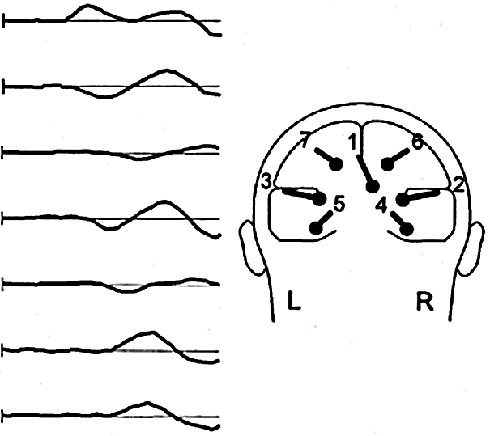
The Superposition Problem
At least 7 components simultaneously active from 50-150 ms for visual stimuli
C1
C2
C3
C4
C5
C6
C7
225 ms
Di Russo et al., 2002
Notes:
Di Russo, F., Martinez, A., Sereno, M. I., Pitzalis, S., & Hillyard, S. A. (2002). Cortical sources of the early components of the visual evoked potential. Human Brain Mapping, 15, 95-111.
Other content: © S. J. Luck. All Rights Reserved. May be used for nonprofit educational purposes if this copyright notice is included. Permission must be obtained from the copyright holder(s) for any other use.

Slide 7
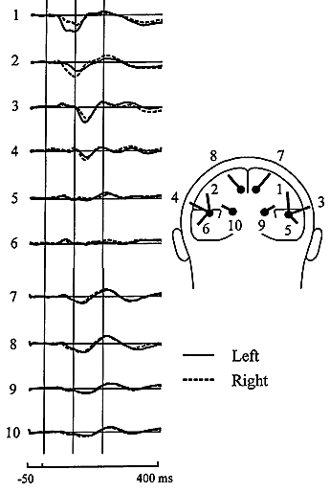
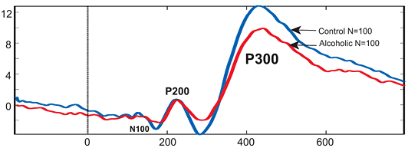
The Superposition Problem
At least 10 components simultaneously active from 50-150 ms for auditory stimuli
How many are active in the P3 period?
Is this really a change in the P3b?
Picton et al., 1999
Notes:
Left portion reprinted from Picton, T. W., Alain, C., Woods, D. L., John, M. S., Scherg, M., Valdes-Sosa, P., et al. (1999). Intracerebral sources of human auditory-evoked potentials. Audiology & Neuro-Otology, 4, 64-79, with permission of S. Karger AG, Basel.
Right portion reprinted from Rangaswamy, Madhavi, & Porjesz, Bernice. (2008). From event-related potential to oscillations: genetic diathesis in brain (dys) function and alcohol dependence. Alcohol Research & Health, 31, 238. (Public Domain)
Other content: © S. J. Luck. All Rights Reserved. May be used for nonprofit educational purposes if this copyright notice is included. Permission must be obtained from the copyright holder(s) for any other use.

Slide 8
Peaks and Components
Observed Waveform
Peak3
Peak1
Peak2
One possible set of source components
C3
C1
C2
Rule #1- Peaks and components are not the same thing. There is nothing special about the point at which the observed waveform reaches a local maximum.
Notes:
Adapted from Figure 2.1 in Luck, Steven J. (2005). An introduction to the Event-Related Potential Technique. Cambridge, MA: MIT Press.© MIT Press. This material may be used for nonprofit research and education purposes only, and it may not be reprinted or distributed in any form including print and electronic forms.
Other content: © S. J. Luck. All Rights Reserved. May be used for nonprofit educational purposes if this copyright notice is included. Permission must be obtained from the copyright holder(s) for any other use.

Slide 9
Peaks and Components
Observed Waveform
Peak3
Peak1
Peak2
Rule #2- It is impossible to estimate the time course or peak latency of an underlying ERP component by looking at a single ERP waveform—there may be no obvious relationship between the shape of a local part of the waveform and the underlying components.
One possible set of source components
C3
C1
C2
Another possible set of source components
C3’
C1’
C2’
Notes:
Adapted from Figure 2.1 in Luck, Steven J. (2005). An introduction to the Event-Related Potential Technique. Cambridge, MA: MIT Press.© MIT Press. This material may be used for nonprofit research and education purposes only, and it may not be reprinted or distributed in any form including print and electronic forms.
Other content: © S. J. Luck. All Rights Reserved. May be used for nonprofit educational purposes if this copyright notice is included. Permission must be obtained from the copyright holder(s) for any other use.

Slide 10
Peaks and Components
Peak3
Peak3
Decrease in C2’ Amplitude
Observed Waveform
Peak1
Peak1
Peak2
Peak2
One possible set of source components
Rule #3- An effect during the time period of a particular peak may not reflect a modulation of the underlying component
C3
C1
C2
Another possible set of source components
C3’
C1’
C2’
Notes:
Adapted from Figure 2.1 in Luck, Steven J. (2005). An introduction to the Event-Related Potential Technique. Cambridge, MA: MIT Press.© MIT Press. This material may be used for nonprofit research and education purposes only, and it may not be reprinted or distributed in any form including print and electronic forms.
Other content: © S. J. Luck. All Rights Reserved. May be used for nonprofit educational purposes if this copyright notice is included. Permission must be obtained from the copyright holder(s) for any other use.

Slide 11
Peaks and Components
Peak3
Peak3
Decrease in C2’ Amplitude
Observed Waveform
Peak1
Peak1
Peak2
Peak2
One possible set of source components
C3
C1
Difference Wave
C2
A difference wave can sometimes reveal the time course of the underlying component.
Hint: Look at scalp distribution at different times
Another possible set of source components
C3’
C1’
C2’
Notes:
Adapted from Figure 2.1 in Luck, Steven J. (2005). An introduction to the Event-Related Potential Technique. Cambridge, MA: MIT Press.© MIT Press. This material may be used for nonprofit research and education purposes only, and it may not be reprinted or distributed in any form including print and electronic forms.
Other content: © S. J. Luck. All Rights Reserved. May be used for nonprofit educational purposes if this copyright notice is included. Permission must be obtained from the copyright holder(s) for any other use.

Slide 12
Difference Waves
Notes:
© S. J. Luck. All Rights Reserved. May be used for nonprofit educational purposes if this copyright notice is included. Permission must be obtained from the copyright holder(s) for any other use.

Slide 13
Peaks and Components
Peak3
Peak3
Decrease in C2’ Amplitude
Observed Waveform
Peak1
Peak1
Peak2
Peak2
Rule #4- Differences in peak amplitude do not necessarily correspond to differences in component size, and differences in peak latency do not necessarily correspond to changes in component timing.
One possible set of source components
C3
Peak3
Increase in C1 Amplitude
C1
Peak1
Peak2
C2
Peak3
Another possible set of source components
C3’
Increase in C3 Amplitude
C1’
Peak1
Peak2
C2’
Notes:
Adapted from Figure 2.1 in Luck, Steven J. (2005). An introduction to the Event-Related Potential Technique. Cambridge, MA: MIT Press.© MIT Press. This material may be used for nonprofit research and education purposes only, and it may not be reprinted or distributed in any form including print and electronic forms.
Other content: © S. J. Luck. All Rights Reserved. May be used for nonprofit educational purposes if this copyright notice is included. Permission must be obtained from the copyright holder(s) for any other use.

Slide 14
Peaks and Components
Difference Waves
Peak3
Decrease in C2’ Amplitude
Peak1
Peak2
Peak3
Increase in C1 Amplitude
Peak1
Peak2
Peak3
Increase in C3 Amplitude
Peak1
Peak2
Notes:
Adapted from Figure 2.1 in Luck, Steven J. (2005). An introduction to the Event-Related Potential Technique. Cambridge, MA: MIT Press.© MIT Press. This material may be used for nonprofit research and education purposes only, and it may not be reprinted or distributed in any form including print and electronic forms.
Other content: © S. J. Luck. All Rights Reserved. May be used for nonprofit educational purposes if this copyright notice is included. Permission must be obtained from the copyright holder(s) for any other use.

Slide 15
Peaks and Components
Rule #5- Never assume that an averaged ERP waveform accurately represents the individual waveforms that were averaged together. In particular, the onset and offset times in the averaged waveform will represent the earliest onsets and latest offsets from the individual trials or individual subjects that contribute to the average.
Notes:
Adapted from Figure 2.1 in Luck, Steven J. (2005). An introduction to the Event-Related Potential Technique. Cambridge, MA: MIT Press.© MIT Press. This material may be used for nonprofit research and education purposes only, and it may not be reprinted or distributed in any form including print and electronic forms.
Other content: © S. J. Luck. All Rights Reserved. May be used for nonprofit educational purposes if this copyright notice is included. Permission must be obtained from the copyright holder(s) for any other use.

Slide 16
Another Problem
Not only is it hard to know what component changed when a given peak was observed to change, it’s also hard to know if the same components are being tapped in different experiments
How do we know that the N400 elicited by a semantically incongruous word is the same as the N400 elicited by a low-frequency word?
We never know for sure
Some components have distinctive properties that make this easier
Examples: LRP and N2pc
Notes:
© S. J. Luck. All Rights Reserved. May be used for nonprofit educational purposes if this copyright notice is included. Permission must be obtained from the copyright holder(s) for any other use.

Slide 17
What to do?
Strategy #1- Focus on a specific component
Strategy #2- Use well-studied experimental manipulations
Strategy #3- Focus on large components
Strategy #4- Isolate components with difference waves
Strategy #5- Focus on components that are easily isolated
Strategy #6- Use component-independent experimental designs
Strategy #7- Hijack useful components from other domains
Strategy #8- Use a component to assess the processes that came before it
#2, #4, #6, and #8 Together- Factorial combination strategy…
Notes:
© S. J. Luck. All Rights Reserved. May be used for nonprofit educational purposes if this copyright notice is included. Permission must be obtained from the copyright holder(s) for any other use.

Slide 18
Attentional Blink N400 Results
Does it matter whether this is really an N400?
Notes:
© S. J. Luck. All Rights Reserved. May be used for nonprofit educational purposes if this copyright notice is included. Permission must be obtained from the copyright holder(s) for any other use.

Slide 19
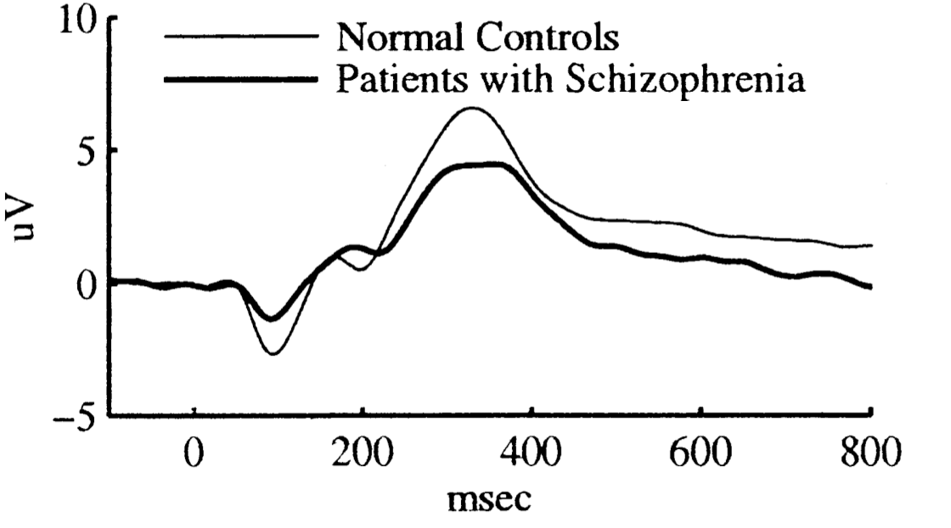
The P3 in Schizophrenia
Typical schizophrenia ERP task- Auditory oddball
80-90% standards of one pitch
10-20% targets of another pitch (count or press for targets)
Measure amplitude of P3 peak for rare stimuli
Large, replicable reduction in P3 amplitude (d = 0.89)
But what does it mean?
Mathalon et al., 2000
Notes:
Bottom portion reprinted from Biological Psychiatry, 47(5). Mathalon, D. H., Ford, J.M., Rosenbloom, M., and Pfefferbaum, A. P300 Reduction and Prolongation with Illness Duration in Schizophrenia. 413-427, Copyright (2000), with permission from Elsevier. This material may be used for nonprofit research and education purposes only, and it may not be reprinted or distributed in any form including print and electronic forms.
Other content: © S. J. Luck. All Rights Reserved. May be used for nonprofit educational purposes if this copyright notice is included. Permission must be obtained from the copyright holder(s) for any other use.

Slide 20
P3 Latency in Schizophrenia
RTs are typically 100-200 ms greater in SC patients
RTs often not reported in P3 studies (most use a counting task in which RT does not apply)
P3 latency only modestly greater in patients
Often not significant
Interesting: RT slowing + no substantial P3 slowing
Mathalon et al., 2000
Notes:
Bottom portion reprinted from Biological Psychiatry, 47(5). Mathalon, D. H., Ford, J.M., Rosenbloom, M., and Pfefferbaum, A. P300 Reduction and Prolongation with Illness Duration in Schizophrenia. 413-427, Copyright (2000), with permission from Elsevier. This material may be used for nonprofit research and education purposes only, and it may not be reprinted or distributed in any form including print and electronic forms.
© S. J. Luck. All Rights Reserved. May be used for nonprofit educational purposes if this copyright notice is included. Permission must be obtained from the copyright holder(s) for any other use.

Slide 21
P3 Latency & Difference Waves
P3 amplitude depends on the probability of a task-defined stimulus category, not the probability of a physical stimulus
P3 difference cannot occur until categorization occurs
Provides a measure of time required to perceive and categorize a stimulus (“stimulus evaluation time”)
Notes:
© S. J. Luck. All Rights Reserved. May be used for nonprofit educational purposes if this copyright notice is included. Permission must be obtained from the copyright holder(s) for any other use.

Slide 22
Methods
3
3
Digit / Letter
p = .80/.20 or p = .50/.50
Left Hand / Right Hand
Duration = 200 ms
SOA = 1500±150 ms
Isolate P3 with Rare-minus-Frequent difference wave
Isolate LRP with Contra-minus-Ipsi difference wave
Luck et al (2009, Psychophysiology)
Notes:
© S. J. Luck. All Rights Reserved. May be used for nonprofit educational purposes if this copyright notice is included. Permission must be obtained from the copyright holder(s) for any other use.

Slide 23
Raw ERP Waveforms
Parietal Electrode Sites
Control RT
Patient RT
486
557
643
734
576
648
P3 amplitude difference for all probability levels
No P3 latency difference
Luck et al (2009, Psychophysiology)
Notes:
© S. J. Luck. All Rights Reserved. May be used for nonprofit educational purposes if this copyright notice is included. Permission must be obtained from the copyright holder(s) for any other use.

Slide 24
P3: Rare Minus Frequent
Parietal Electrode Sites
No P3 amplitude difference
No P3 latency difference
Conclusion: RT slowing not due to slowed perception or categorization (at least in simple tasks)
Luck et al (2009, Psychophysiology)
Notes:
© S. J. Luck. All Rights Reserved. May be used for nonprofit educational purposes if this copyright notice is included. Permission must be obtained from the copyright holder(s) for any other use.

Slide 25
Response-Locked P3
StimulusP3 not delayed
StimulusResponse is delayed
Prediction: P3Response should be delayed
Parietal Electrode Sites
Significant P3 onset latency difference
Luck et al (2009, Psychophysiology)
Notes:
© S. J. Luck. All Rights Reserved. May be used for nonprofit educational purposes if this copyright notice is included. Permission must be obtained from the copyright holder(s) for any other use.

Slide 26
LRP: Contra Minus Ipsi
C3/C4 Electrode Sites
Significant amplitude difference
Significant onset latency difference
Significant amplitude difference
Marginally significant onset latency difference
Notes:
© S. J. Luck. All Rights Reserved. May be used for nonprofit educational purposes if this copyright notice is included. Permission must be obtained from the copyright holder(s) for any other use.

Slide 27
Sustained Visual-Spatial Attention
Comparison of Attended and Ignored Standards
O1/O2
Does it matter which component was influenced by attention?
Time relative to stimulus onset
Notes:
© S. J. Luck. All Rights Reserved. May be used for nonprofit educational purposes if this copyright notice is included. Permission must be obtained from the copyright holder(s) for any other use.

Slide 28
Factorial Combination of Manipulation to Isolate Component and Manipulation of Interest
Oddball task
Single-Digit condition: Rare = 5; Frequent = 0-4,6-9
Odd-Even condition: Rare = odd; Frequent = even
Single-Digit should be categorized faster than Odd-Even
Notes:
© S. J. Luck. All Rights Reserved. May be used for nonprofit educational purposes if this copyright notice is included. Permission must be obtained from the copyright holder(s) for any other use.

Slide 29
Experimental Design
“Perhaps the decisive factor is fanatical care beyond the obvious stuff: the obsessive attention to details that are often overlooked”
Jony Ive Interview with the Design Museum
Notes:
http://designmuseum.org/design/jonathan-ive/

Slide 30
Confounds and Side Effects
Confound: You explicitly manipulate two things together
Target is “X” / p = .1; Standard is “Y” / p = .9
“That can’t possibly be producing my effect…”
Confounds that “don’t matter” in behavioral experiments often matter in ERP experiments
Form and timing of the stimuli
Side effect: You manipulate one thing, but that one thing indirectly influences other things
Condition A: SOA = 500 ms; Condition B: SOA = 1000 ms
Subjects are bored in Condition B
Overlap distorts waveforms in Condition A
Potentially infinite number of side effects
Notes:
© S. J. Luck. All Rights Reserved. May be used for nonprofit educational purposes if this copyright notice is included. Permission must be obtained from the copyright holder(s) for any other use.

Slide 31
Confounds and Side Effects
Side effects are sometimes impossible to avoid
Even true confounds may be hard to avoid
Example: ERPs to content vs. function words
If you can’t eliminate them, show that they don’t actually produce the observed effect
Example: Embedded words
BITE vs. PECK
Looking for early differences
Might be sensory differences between word classes
Solution: Test speakers of two different languages
This is a lot of work
But if the experiment is worth doing, it should be worth the effort to do it right (take pride in your experiments!!!)
Notes:
© S. J. Luck. All Rights Reserved. May be used for nonprofit educational purposes if this copyright notice is included. Permission must be obtained from the copyright holder(s) for any other use.

Slide 32
Example Experiment
Goal
Examine P3 for easy and difficult discriminations
Design
Oddball experiment with foveal stimuli at 1/sec
X on 20% of trials; O on 80% of trials
Press a button for X; no response for O
No target repetitions
Stimuli are bright or dim (different blocks)
Analysis
P3 amplitude measured as baseline-to-peak voltage
Notes:
© S. J. Luck. All Rights Reserved. May be used for nonprofit educational purposes if this copyright notice is included. Permission must be obtained from the copyright holder(s) for any other use.

Slide 33
Problems and Solutions
Problem: Target and standards are physically different
Different stimuli elicit different ERPs
Sensory responses can persist for hundreds of ms
Differential adaptation
The Hillyard Principle- Always compare ERPs elicited by the same physical stimuli, varying only the psychological conditions
Solution: Use 5 characters; each is target in one of 5 trial blocks
Notes:
© S. J. Luck. All Rights Reserved. May be used for nonprofit educational purposes if this copyright notice is included. Permission must be obtained from the copyright holder(s) for any other use.

Slide 34
Differential Adaptation
O
O
O
O
X
O
O
O
O
X
O Detectors
X Detectors
X
X
X
X
O
X
X
X
X
O
O Detectors
X Detectors
A
E
C
D
B
D
C
A
B
E
Notes:
© S. J. Luck. All Rights Reserved. May be used for nonprofit educational purposes if this copyright notice is included. Permission must be obtained from the copyright holder(s) for any other use.

Slide 35
Violations of Hillyard Principle
Luck & Hillyard (1994)
Notes:
© S. J. Luck. All Rights Reserved. May be used for nonprofit educational purposes if this copyright notice is included. Permission must be obtained from the copyright holder(s) for any other use.

Slide 36
Violations of Hillyard Principle
Luck & Hillyard (1994)
Notes:
© S. J. Luck. All Rights Reserved. May be used for nonprofit educational purposes if this copyright notice is included. Permission must be obtained from the copyright holder(s) for any other use.

Slide 37
Solving Stimulus Confounds
Problem: Brightness manipulation has side effect of changing sensory components
Solution 1: Control experiment to show that brightness per se does not impact P3 amplitude
Solution 2: Compare rare-minus-frequent difference waves for bright vs dim
Notes:
© S. J. Luck. All Rights Reserved. May be used for nonprofit educational purposes if this copyright notice is included. Permission must be obtained from the copyright holder(s) for any other use.

Slide 38
Problems and Solutions
Problem: Subjects make response to target, not to standards
Motor activity contaminates P3
Solution: Separate responses for target & standards
Problem: Target always preceded by nontarget
Nontarget baseline contaminated by overlap from previous P3
Solution 1: Completely random sequence
Solution 2: During averaging, exclude nontargets preceded by targets
Notes:
© S. J. Luck. All Rights Reserved. May be used for nonprofit educational purposes if this copyright notice is included. Permission must be obtained from the copyright holder(s) for any other use.

Slide 39
Differential Overlap
Notes:
Adapted from Figure 4.4 from from Luck, S.J. (2014). An Introduction to the Event-Related Potential Technique, Second Edition. Cambridge, MA: MIT Press. © MIT Press.
This material may be used for nonprofit research and education purposes only, and it may not be reprinted or distributed in any form including print and electronic forms.

Slide 40
Peak Amplitude and Noise
Problem: Peak amplitude biased by number of trials
Solution: Mean amplitude or select a random subset of nontargets
Clean Waveform
Waveform + Noise
Notes:
© S. J. Luck. All Rights Reserved. May be used for nonprofit educational purposes if this copyright notice is included. Permission must be obtained from the copyright holder(s) for any other use.

Slide 41
Problems and Solutions
Problem: Subjects may be in a different state of arousal during bright and dim blocks
Solution: Mix brightness levels within blocks
Notes:
© S. J. Luck. All Rights Reserved. May be used for nonprofit educational purposes if this copyright notice is included. Permission must be obtained from the copyright holder(s) for any other use.

Slide 42
More Rules
Rule #6- Whenever possible, avoid physical stimulus confounds by using the same physical stimuli across different psychological conditions
Rule #7- When physical stimulus confounds cannot be avoided, conduct control experiments to assess their plausibility
Rule #8- Be cautious when comparing averaged ERPs that are based on different numbers of trials
Rule #9- Be cautious when the presence or timing of motor responses differs between conditions
Rule #10- Whenever possible, experimental conditions should be varied within rather than between trial blocks
Notes:
© S. J. Luck. All Rights Reserved. May be used for nonprofit educational purposes if this copyright notice is included. Permission must be obtained from the copyright holder(s) for any other use.

Slide 43
Timing Advice
Duration for visual stimuli
100-200 ms, or else longer than time period of interest
>100 ms -> Offset response
<100 ms -> dimmer, not shorter
Notes:
Adapted from Figure 4.3 from from Luck, S.J. (2014). An Introduction to the Event-Related Potential Technique, Second Edition. Cambridge, MA: MIT Press. © MIT Press.
Other content: © S. J. Luck. All Rights Reserved. May be used for nonprofit educational purposes if this copyright notice is included. Permission must be obtained from the copyright holder(s) for any other use.

Slide 44
Timing Advice
Trial duration
As short as possible to maximize # trials/session
But longer means fewer overlap problems
And longer means less sensory adaptation
>=1500 ms if subjects respond on every trial
Add jitter of at least ±50 ms to avoid alpha entrainment
Add more jitter to reduce overlap
Your system may have a delay between the event code and the actual stimulus
LCD monitors typically have a delay of 5-30 ms before anything is presented
CRT monitors start at the top of the screen, so stimuli appear with a delay of 10-15 ms near the bottom
You should measure this and adjust accordingly
Notes:
© S. J. Luck. All Rights Reserved. May be used for nonprofit educational purposes if this copyright notice is included. Permission must be obtained from the copyright holder(s) for any other use.

Slide 45
Some General Advice
ERP experiments are hard to design perfectly
You will constantly be frustrated by the need to balance the number of conditions with the number of trials per condition
Keep each experiment as simple as possible, and realize that you will probably need multiple experiments
The additional experiments will provide replications
In the end, this will save you time
Each experiment will teach you something that will allow you to do a better job with the next experiment
“Don’t try to do the last experiment first”
“Context of Discovery” vs. “Context of Justification”
Notes:
© S. J. Luck. All Rights Reserved. May be used for nonprofit educational purposes if this copyright notice is included. Permission must be obtained from the copyright holder(s) for any other use.

